Slide 1
The Intelligence Operating System
From Chatbots to Agentic Operations

Slide 2

Introductions
Christian
Husband
Father
Passionate Geek
Life-long learner

Slide 3
Before We Begin
Two questions for you
1. Where do you spend most of your time in a typical workday?
(Not the most important thing — the biggest time sink)
2. What do you already know or believe about AI?
How have you started using it (if at all)?
Write these down. We'll come back to them.
Notes:
PARTICIPATION BEAT #1: Give 2-3 minutes. Primes them for task-mapping later.

Slide 4
State of the Industry

Slide 5
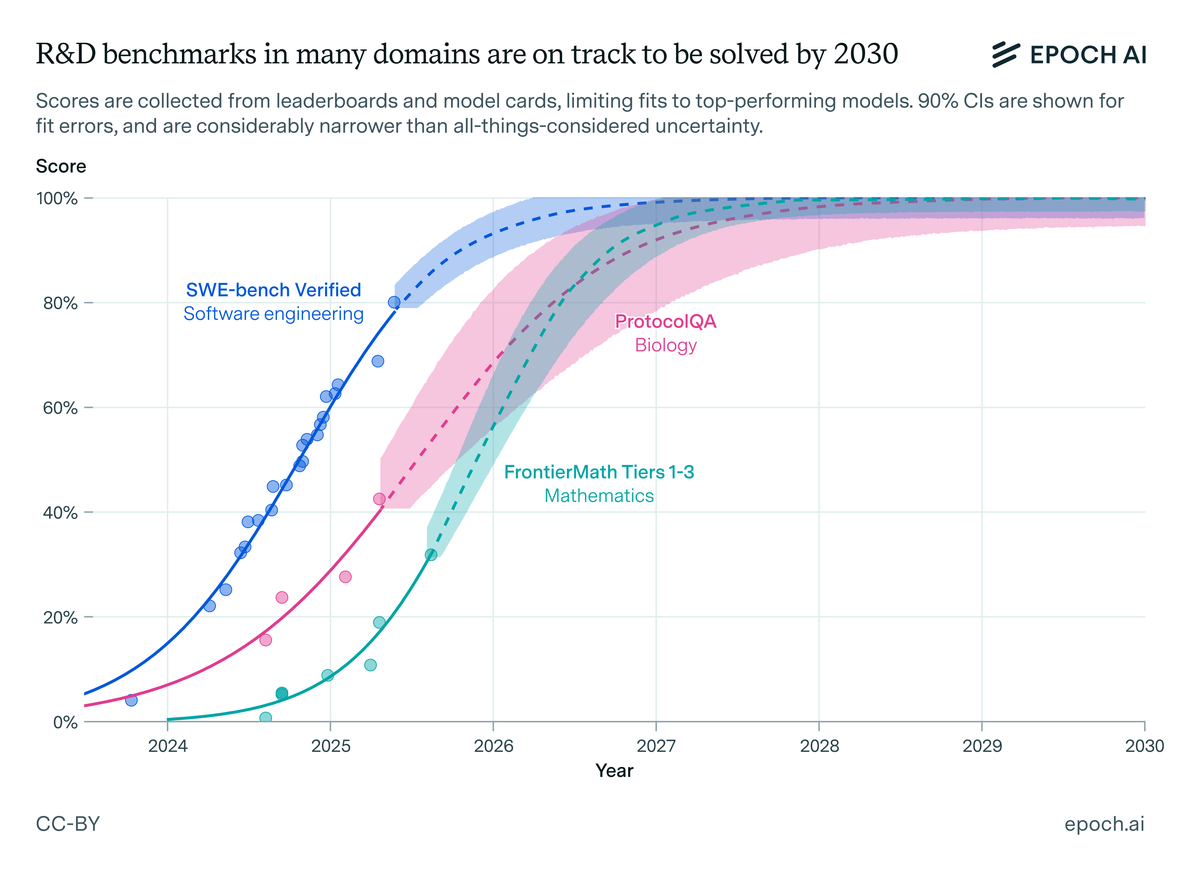
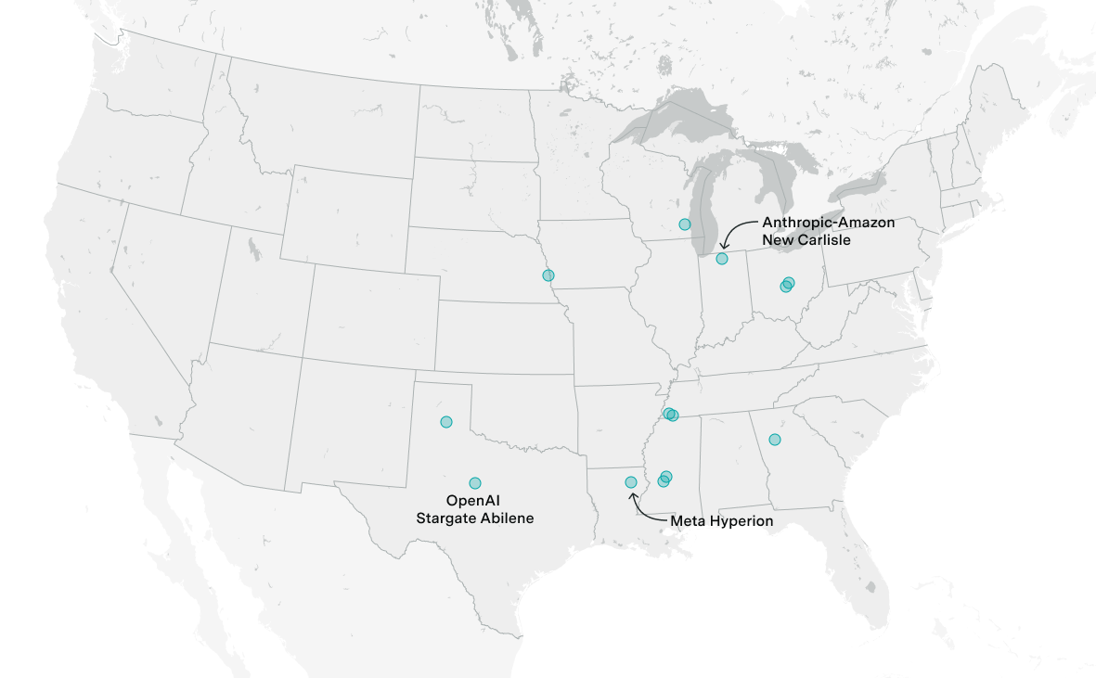
Where are we today?
Notes:
===AGI – the robots are coming for us (replacing ½ of accountants/lawyers)
This is showing training, which ultimately requires electricity. So this is the cost of electricity (9x increase since 2010)
We’ve all heard about the grid and the challenges we’ve had so far. There’s some interesting efforts to alleviate it (nuclear, etc.) but it’s still early and this could pan out.
The point that’s relevant for us today is that the best model we currently have took $750M to train & datacenter cost $5B to house it
That’s capex – and you’re not one of the big boys in this game. You’re going to use one of them because you don’t want to sink the $5B

Slide 6
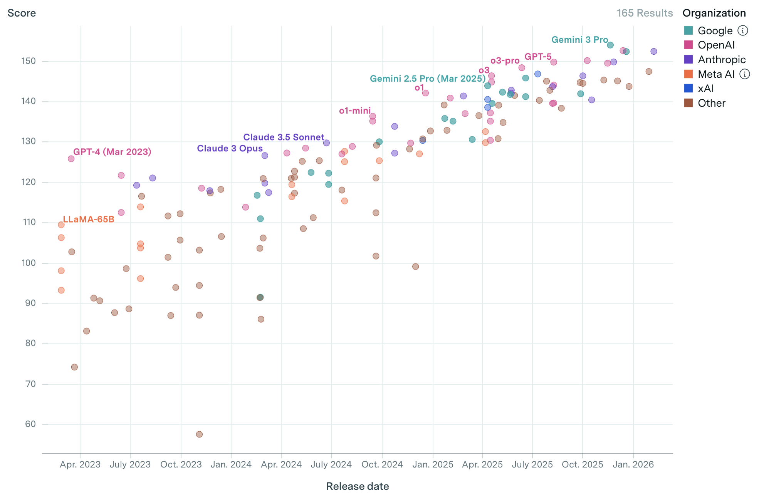
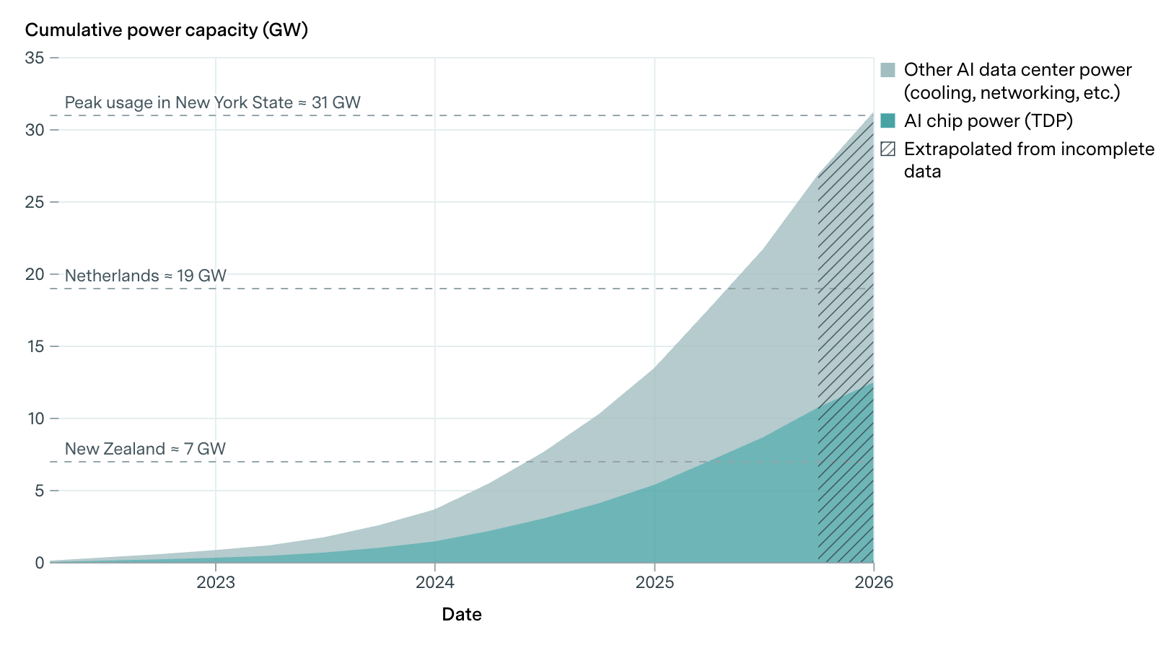
Where are we today?
Notes:
The cost of using them is dropping – whereas before this was majorly subsidized, optimizations, and progress have pulled this down.
We are seeing a normalizing towards about $30/mo for typical usage because of hardware advantages.
This is your op-ex - you’re going to pay for subs to tools because they need to pay off their cap-ex. Remember they sank over $5B into getting here and need to make their money back.

Slide 7
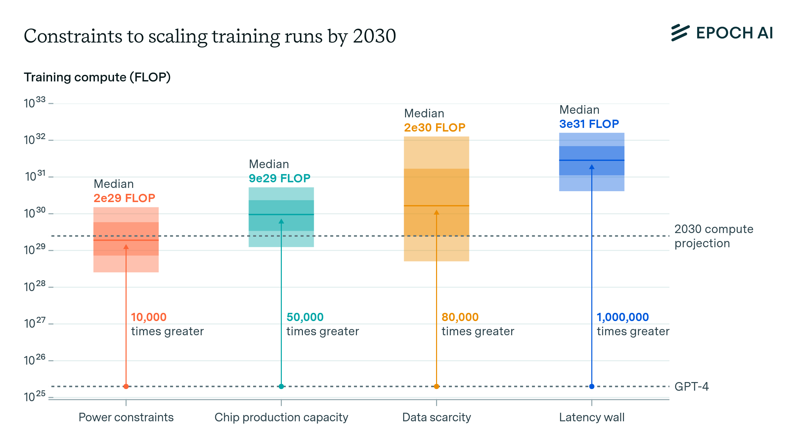
Understanding Demand
Notes:
Epoch AI is a great resource (you can lose days digging around in their stuff) and I’m going to pull out some of what I believe it most relevant.
Here’s what we are looking at: this graph is showing us what it would take across the 4 major factors to achieve the 2030 compute that’s projected
Far left: this is the power – we need about 10K times more
Chip capacity is next – about 50K times more
Data is a huge factor and we will need 80K times more – mind you this is from GPT-4 (not from start) so this means all those huge gains we’ve had so far aren’t part of the 80K
Latency wall – ok, this is an obtuse term but what it means is the speed with which we can process something. 1M times more means we are now talking about data transfers that exceed the speed of light

Slide 8
What does it look like going forward?

Slide 9
The Fundamental Shift in How We Work
Yesterday
Tomorrow
You
You
Agent
Agent
Agent
AI Tool
Factory operator managing agent swarms
Individual using AI as a tool
2

Slide 10
AI Is Your Wingman, Not the Lead Pilot
Accountability cannot be delegated to a machine
The Boeing Loyal Wingman: fully autonomous weapons vehicle.
No cockpit. No drone operator. If it decides to act, nothing stops it.
But the lead pilot is responsible.
If the wingman commits a war crime, the lead pilot faces the tribunal.
The same applies to AI in your business:
• Agents can operate autonomously (Stages 5-8)
• But YOU own the outcomes
• Governance is your chain of command
Notes:
WINGMAN METAPHOR: Mental model for the entire deck. Everything after — governance, quality gates, landing zones — flows from this.

Slide 11

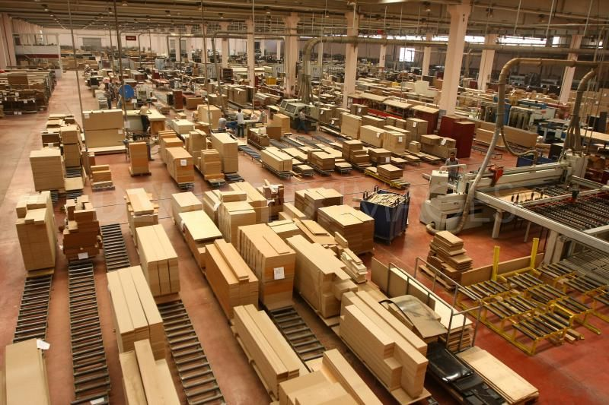

Slide 12
The Trust Evolution: 8 Stages of AI Adoption
8
7
Orchestrator
6
10+ Agents
Factory operator
5
Multi-Agent
4
Hosted Agents
3
Wide Agent
2
Autonomous
1
Permissions
Zero AI
Wave 1: Chatbots
Wave 2: Insights
Wave 3: Agentic Operations
As trust increases, humans shift from doing to directing
3
Source: Adapted from Steve Yegge's Developer-Agent Evolution Model (2026)

Slide 13
Three Waves of Enterprise GenAI
$5.4B
$52B+
Enterprise AI Market
1
2
3
CHATBOTS
INSIGHTS
AGENTIC
2022-2023
2024-2026
2027+
Stages 1-2
Stages 3-4
Stages 5-8
Permission-based Single interactions Human does the work
Autonomy emerges Wider context Human reviews output
Multi-agent swarms Orchestration Human directs
4

Slide 14
THE CRITICAL MOMENT
The Autonomy Inflection Point
Before: Permission Mode
After: Autonomous Mode
• Human approves every action • AI waits for permission • Slow but controlled • Trust is low • Human does verification
• AI acts autonomously • Permissions turned off • Fast but risky • Trust is high • Governance becomes critical
When you turn off permissions, governance infrastructure becomes essential
5

Slide 15
The Intelligence Operating System
Infrastructure for the autonomous era: Governance when permissions are off
6

Slide 16
The Three Layers of Intelligence OS
LAYER 1
Human expertise + AI swarms working together From tool user to factory operator
Hybrid Intelligence
LAYER 2
The safety net for autonomous mode Boundaries, trust, accountability
Governance Engine
LAYER 3
Orchestration infrastructure How you manage 10+ agents at scale
Operating Model
7

Slide 17
The Role Evolution: Contributor → Operator
Doer
Reviewer
Director
Operator
You do the work
AI drafts, you review
You direct, AI executes
You orchestrate agent swarms
Stages 1-2
Stages 3-4
Stages 5-6
Stages 7-8
Low Trust
Trust Increases →
High Trust
Your value shifts from doing work to directing outcomes
8

Slide 18
The Agentic Factory: You as Operator
THE OPERATOR: Strategy, Direction, Quality Gates
Research Agent
Analysis Agent
Planning Agent
Execution Agent
QA Agent
Deploy Agent
Human Clarification
Human Approval
Human Approval
GOVERNANCE: Monitoring, Boundaries, Audit Trail (Your Autonomy Safety Net)
Source: Factory metaphor adapted from Gas Town (Yegge, 2026)
9

Slide 19
Construction
Majority at Stage 1–2 | Leaders at Stage 3 | Ceiling: Stage 4

Slide 20
Construction: The Hard Data
1
2
3
4
5
6
7
8
■ Achieved ■ Leaders Today ■ Near-Possible ■ Not Yet
27%
of AEC firms use AI at all (Bluebeam 2025, n=1,000)
<1%
have organization-wide AI (RICS 2025, n=2,200+)
79%
have little to no AI implementation (GiaSpace 2026)
The industry is overwhelmingly at Stages 1–2: 45% report no AI at all (RICS). 52% still use paper during design. 29% have no AI capability or plans. Where AI exists, it's individual chatbot usage — summarizing specs, drafting emails — all with human permission. 63% of firms are only now planning ERP modernization needed to enable anything beyond Stage 2.

Slide 21
Construction: What's Deployed vs. What's Not
Focus: Production systems only — not roadmaps
✅ Deployed Today
Procore AI Agents (open beta Jan '26) — RFI, Daily Log, custom Agent Builder
Autodesk Construction IQ — ML risk scoring for submittals/RFIs
OpenSpace / Buildots / Doxel — Computer vision progress tracking vs BIM
ALICE Technologies — Generative AI schedule optimization (thousands of scenarios)
Bechtel "change" agent — Evaluates scope change cascading impacts
Hakimo (Skanska) — AI jobsite security with autonomous alert filtering
❌ Not Happening Yet
No multi-agent coordination on any construction project
No autonomous procurement or subcontractor management
No AI agents executing change orders without human approval
No orchestrated swarms managing project lifecycle
No widespread 'permissions off' autonomous workflows
Most firms lack connected data infrastructure for Stage 4+

Slide 22
Construction: Stage-by-Stage Reality
Near-possible ceiling: Stage 4 by late 2026
Stage 1–2: MAJORITY HERE
45% report zero AI (RICS). 52% use paper in design. 34% in early pilots. Individual chatbot experiments with full human approval.
Stage 3: LEADERS ONLY
Top firms (Bechtel, Skanska, Mortenson) running single agents with some permissions off — schedule risk alerts, AI-generated RFIs, automated progress docs. Procore Agent Builder in open beta.
Stage 4: NEAR-POSSIBLE CEILING
Procore's Datagrid acquisition (Jan 2026) targets cross-system agent workflows. BuiltWorlds forecasts 2026 for agents trained on good datasets. Requires ERP modernization most firms are only planning.
Stage 5–8: NOT YET
No hosted multi-agent systems, orchestration, or 10+ agent swarms anywhere in construction. BuiltWorlds projects 2027 for AI decision-making. Deloitte notes digital twins 'expected standard' but not yet agentic scale.

Slide 23
Financial Services
Majority at Stage 3–4 | Leaders at Stage 5–6 | Ceiling: Stage 6–7

Slide 24
Financial Services: The Clear Leader
1
2
3
4
5
6
7
8
■ Achieved ■ Leaders Today ■ Near-Possible ■ Not Yet
400+
production AI use cases at JPMorgan (early 2026)
21%
of financial firms have deployed AI agents (NVIDIA 2026)
~100%
plan to increase or maintain AI budgets (NVIDIA 2026)
The industry has moved from 'AI-assisted human' to 'human-supervised AI': Microsoft identifies financial services as having the highest concentration of 'Frontier Firms' — organizations embedding AI agents across every workflow. JPMorgan deploys tools to 200,000+ employees (over half use AI multiple times daily). Goldman Sachs AI does 95% of an IPO prospectus 'in minutes.' One Forrester-studied firm runs 60 agentic agents in production with plans for 200 more.

Slide 25
Financial Services: What's Deployed vs. Emerging
Major banks operating in production at Stage 5+
✅ In Production Today
JPMorgan OmniAI — 400+ use cases, 200K employees, Coach AI for advisors, targeting 1,000+ by year-end
Goldman Sachs — GS AI Assistant firmwide, thousands of AI coders (Devin), AI agents doing accounting & compliance (Claude)
Citi — Agentic AI to developers, autonomous software patches in production
Morgan Stanley — GPT-4 assistant for 16,000+ advisors querying 100K+ documents
BBVA Peru — Blue Buddy agentic AI, 83% digital resolution rate
One firm: 60 agents in production, planning 200 more (Forrester)
Autonomous payment routing — Sub-200ms transaction decisions at multiple institutions
🔄 Emerging, Not Scaled
Multi-agent orchestration across departments (most agents still domain-specific)
10+ agent swarms with orchestration (Goldman AAS moving this way, not fully autonomous)
Fully autonomous trading decisions (regulatory human-in-the-loop required)
Cross-institution agent-to-agent (Visa/Mastercard frameworks expected, not live)
CFPB requiring AI agents to register as loan officers — governance catching up
Only 1 in 5 companies has mature governance for autonomous agents (Deloitte)

Slide 26
Financial Services: Stage-by-Stage Reality
Near-possible ceiling: Stage 6–7 (back-office pockets)
Stage 1–2: PASSED
Major banks moved through chatbot/copilot phases in 2023–24. Morgan Stanley advisor assistant (Sept 2023) was early Stage 2. Fully behind them for Tier 1.
Stage 3: INDUSTRY NORM
Autonomous single agents are table stakes — fraud detection, document processing, risk scoring all run with minimal human intervention. Goldman AI does 95% of IPO prospectuses.
Stage 4: ACTIVE
Agents with wider context. JPMorgan 400+ use cases spanning back-office, wealth, risk, trading. Goldman GS AI Assistant is model-agnostic (GPT, Gemini, Claude). Multi-step workflows like credit memos, cross-currency reconciliation.
Stage 5–6: LEADERS HERE → EMERGING
Top 10 banks have hosted, production-grade agent infrastructure. JPMorgan OmniAI, Goldman Agent-as-a-Service, Citi developer agents. One firm runs 60 production agents. Goldman deploying thousands of AI coders alongside 12K humans. True inter-agent collaboration is early.
Stage 7: NEAR-POSSIBLE
The 60-agent firm (planning 200 more) approaches Stage 7. Goldman's AI coder fleets operate as agent swarms. But orchestration governance across 10+ autonomous agents still maturing.
Stage 8: NOT YET
No true factory-operator orchestration. SEC/CFPB mandate human-in-the-loop for high-stakes decisions. Only 20% have mature autonomous agent governance.

Slide 27
Manufacturing
Majority at Stage 2–3 | Leaders at Stage 4–5 | Ceiling: Stage 5–6

Slide 28
Manufacturing: Deep ML Heritage, Emerging Agentic
1
2
3
4
5
6
7
8
■ Achieved ■ Leaders Today ■ Near-Possible ■ Not Yet
77%
of manufacturers use AI (up from 70% in 2024)
6%→24%
agentic AI adoption increase expected in 2026 (Deloitte)
20%
feel fully prepared for AI at scale (Redwood 2026)
A unique middle position — deep traditional AI/ML, emerging agentic: Process manufacturing has embedded AI routines for decades (process control, predictive maintenance, computer vision). But the jump to GenAI/agentic has been slower than financial services. 98% are exploring AI automation but only 20% ready for scale. Deloitte forecasts a 4× increase in agentic adoption during 2026. Only 5% of GenAI projects reached enterprise scale in 2025 (MIT).

Slide 29
Manufacturing: What's Deployed vs. What's Not
Strong in traditional AI, emerging in agentic
✅ Deployed Today
Siemens Industrial AI Agents — Orchestrator deploys specialized agents, Engineering Copilot generates code via NL
Siemens × NVIDIA — Building world's first fully AI-driven factory (Erlangen, starting 2026)
BMW — Agentic AI robots autonomously spot bottlenecks, adjust manufacturing processes
GE Aviation — Agentic AI monitors machinery, detects issues without human intervention
Siemens Senseye — Predictive maintenance across 10,000+ assets, 4 continents, 12% downtime reduction in 12 weeks
40% of manufacturers upgrading scheduling with AI autonomous capabilities (IDC 2026)
❌ Not Happening Yet
Only 5% of GenAI/agent projects reach enterprise scale (MIT 2025)
Multi-agent orchestration across full production lifecycle is aspirational
IT/OT data integration fragmented — 40% integrated by 2027 (IDC forecast)
Workforce resistance: 'taking away the fun part of engineering' (IDC)
40% of agentic AI projects at risk of cancellation by 2027 (Gartner)
Physical AI in safety-critical environments still requires heavy human oversight

Slide 30
Manufacturing: Stage-by-Stage Reality
Near-possible ceiling: Stage 5–6 by late 2026
Stage 1–2: MAJORITY HERE
77% use AI but mostly at Stage 2 — quality inspection, basic predictive maintenance, document analysis with human permission. 98% exploring but only 20% ready for scale. Deep ML maturity, shallow GenAI/agentic maturity.
Stage 3: ACTIVE (LEADERS)
Top manufacturers have autonomous single-agent workflows: predictive maintenance without approval, computer vision auto-rejecting defects, autonomous scheduling adjustments. BMW robots making proactive changes. GE autonomous monitoring.
Stage 4–5: LEADERS HERE → EMERGING
Siemens Industrial Copilot ecosystem = Wide Agent territory. 45% of G2000 OEMs connecting field/engineering data via AI by end 2026 (IDC). Siemens' orchestrator deploying specialized agents = Stage 5 infrastructure. Erlangen factory is bleeding-edge, not mainstream.
Stage 6: NEAR-POSSIBLE
Siemens' digital + physical (robot) agents coordinating tasks is multi-agent architecture. Smart factory sense-decide-act loops across lines. But only at very leading edge and just starting in 2026.
Stage 7–8: NOT YET
IDC: 65% of G1000 using AI agents in design/simulation by 2028. Software-defined factory with centralized control via open platforms: 2029 (IDC). Full autonomous orchestration is a 2028–29 vision.

Slide 31
Why the Gap? Accelerators vs. Constraints
Understanding what drives maturity differences
What Accelerates Maturity
Digital-native workflows — Finance operates on data; construction operates on dirt
Massive IT budgets — JPMorgan: $18B/yr on tech vs. fraction at mid-size GCs
Clean, structured data — Financial transactions structured by nature; construction data in PDFs and handwritten logs
Clear ROI metrics — Every basis point in routing = revenue; construction gains harder to measure
Competitive pressure — Fintechs force innovation or death; construction faces less tech disruption
What Constrains Maturity
Regulatory requirements — Finance has strictest AI governance, paradoxically enables and limits
Physical-world risk — Manufacturing errors injure people; financial errors are monetary
Workforce culture — 52% of construction uses paper; engineers resist AI 'taking away the fun'
Data fragmentation — Construction and manufacturing suffer from siloed OT/IT legacy systems
Governance gaps — Only 20% of companies globally have mature autonomous agent governance (Deloitte)

Slide 32
Pause: Where Does This Land?
Looking back at what you wrote at the start
Your biggest time sink — which industry vertical does it relate to?
Could an agent handle part of it?
What stage would that require?
Turn to a neighbor and share one reaction.
Notes:
PARTICIPATION BEAT #2: 2-3 minutes. Grounds the abstract in their real work.

Slide 33
RESEARCH
Governance: The Autonomy Safety Net
Autonomy Without Governance
Autonomy With Governance
20%
45%
Success Rate
Success Rate
As trust increases and permissions decrease, governance becomes critical infrastructure
10
Source: Gartner AI Governance Research (2024)

Slide 34
RESEARCH
Human-in-the-Loop: Even in Autonomous Mode
Full Manual
Human + AI
Full Autonomy
85%
94%
73%
Stage 1-2
Stage 5-6
Stage 8 risk
You do everything
You direct, AI executes
AI alone, no oversight
Even with 10+ agents, the operator's judgment remains the quality gate
11
Source: MIT Sloan Management Review (2024)

Slide 35
Making It Real
From Stage 3 to Stage 8: A practical path
12

Slide 36
AI Impact: Is the Task Demand-Limited?
The supply vs. demand lens
SUPPLY-LIMITED TASKS (AI compresses time):
• Writing reports: 4 hours → 30 minutes
• Code reviews: 2 hours → 20 minutes
• Data analysis: full day → 1 hour
DEMAND-LIMITED TASKS (AI doesn't help much):
• You only need 1 invoice per transaction
• You only file taxes once per year
• The bottleneck is the customer, not the task
Ask: If AI made this 10x faster, would you do 10x more of it?
Notes:
DEMAND-LIMITED FRAMEWORK from Workshop v6.

Slide 37
AI Impact: Which Tasks Collapse?
Some tasks don't just get faster — they disappear entirely
COLLAPSIBLE (the task itself goes away):
• Manual data entry → auto-extraction
• Scheduling coordination → AI scheduler
• First-pass document review → AI triage
NON-COLLAPSIBLE (still needs a human, just faster):
• Strategic decisions
• Client relationship management
• Creative direction
The question isn't 'will AI take my job?'
It's 'which parts of my job collapse?'
Notes:
COLLAPSIBILITY from Workshop v6. Sets up the 2x2 matrix.

Slide 38
The AI Impact Matrix
Map every role in your organization
HIGH TIME IMPACT + LOW DEMAND LIMIT → DO MORE
Expect way more output. Growth plan + tooling.
HIGH TIME IMPACT + HIGH DEMAND LIMIT → GROW THE ROLE or REDUCE
Cross-train. Payroll person does AP/AR. Or reduce headcount.
LOW TIME IMPACT + LOW DEMAND LIMIT → WAIT
Not worth investing now. Incremental improvement only.
LOW TIME IMPACT + HIGH DEMAND LIMIT → SCALE
Add headcount + incremental improvement.
Notes:
2x2 MATRIX from Workshop v6. Each quadrant = clear action.

Slide 39
RESEARCH
Why Multi-Agent Autonomy Needs Quality Gates
The Problem
84%
20 agents at 84% each: 0.84^20 = 3% Nearly all your swarm output fails!
71%
42%
18%
3%
Agent 1
Agent 5
Agent 10
Agent 15
Agent 20
Quality gates between agent stages prevent cascade failures in autonomous mode
13
Source: Error propagation research applied to multi-agent systems

Slide 40
RESEARCH
The Skill Leveling Effect ( before stage 4 )
Junior Skills Users (Learning)
Strategic Insight
+35% Productivity Gain
AI democratizes capability across stages. Those at early career stages gain the most. Stage 7-8 operators add value through orchestration, not individual output.
Expert Users
+3%
Source: Fortune 500 Enterprise AI Analysis (2024)
14

Slide 41
Where to Deploy Your Agent Swarm
FULL AUTONOMY Stages 7-8 Maximum agent independence
DIRECTED AUTONOMY Stages 5-6 Human oversight at key gates
Task Volume
SUPERVISED AGENTS Stages 3-4 Agent drafts, human reviews
HUMAN-LED Stages 1-2 AI as tool only
Precision Required
15

Slide 42
OBJECT LESSON
From Stage 3 to Stage 7: A Developer's Journey
Stage 3
Stage 5
Stage 7
Autonomous IDE
CLI Agent
10+ Agents
Permission off Review diffs
Faster cycles Multiple tasks
Orchestration Quality gates
26%
3-5x
10+
∞
Faster at Stage 3
Parallel at Stage 5
Agents at Stage 7
Potential
16

Slide 43
The Adoption Path
Climbing the trust ladder systematically
17

Slide 44
Enterprise AI Maturity (Mapped to Evolution)
Operational
Stages 7-8
Strategic
Orchestration Intelligence OS
Stages 5-6
Experimental
Multi-agent pilots Formal governance
Stages 3-4
Ad-Hoc
Pilots, autonomy emerging Basic guidelines
Stages 1-2
Individual experiments No governance
18

Slide 45
Your Path Up the Trust Ladder
Week 1
Month 1
Quarter 1
Identify
Pilot
Scale
Find 3 tasks for Stage 3 autonomous mode
Run Stage 4-5 pilots with governance
Build toward Stage 6-7 operations
Each stage builds trust for the next. Don't skip steps.
19

Slide 46
How to Get Started Tomorrow
Becoming a superhuman — 1% at a time
PROBLEM SELECTION:
• List the top 10 things you do each week by time
• Star the ones you HATE doing
• Pick the highest-time starred item
EXPLORATION:
• Spend 30 minutes trying to automate it
• Test with a free AI tool (ChatGPT, Claude, Copilot)
• Document what worked and what didn't
ITERATION:
• Refine the prompt/workflow over one week
• Measure actual time saved
• Share the win with your team
Notes:
1% IMPROVEMENT from Workshop v6. Concrete, actionable takeaway.

Slide 47
The Agentic Landing Zone
Infrastructure for Stage 4-8 operations: Your autonomy safety net at scale
20

Slide 48
What Is an Agentic Landing Zone?
Stage 3-6 Pilots
Stage 7-8 Production
Agents
Pre-configured infrastructure: • Governance guardrails • Security boundaries • Orchestration patterns • Quality gates
Enables safe progression from Stage 3 to Stage 8 without building everything yourself.
21

Slide 49
Agentic Landing Zone: Six Components
1
Governance
2
Orchestration
3
Tool Registry
Your autonomy safety net
Multi-agent coordination
Approved agent capabilities
4
Knowledge
5
Observability
6
Security
Shared context for swarms
Monitor your factory
Boundaries that scale
22

Slide 50
Reflection
Looking back at what you wrote at the start
Your biggest time sink — could an agent handle part of it?
Where does that task fall on the AI Impact Matrix?
(Demand limited? Time compressible?)
What stage would you need to reach to automate it?
What's your first 1% step this week?
Notes:
PARTICIPATION BEAT #3: Full circle. Give 3-5 minutes, then ask for volunteers.

Slide 51
Your Next Move
Where are you on the trust ladder?
24

Slide 52
Three Questions to Answer Now
1
2
3
What stage are you at today?
What's your path to autonomy safely?
Who will operate your agent factory?
Most are Stage 2-4. Few are ready for 7-8.
Governance first, then scale trust.
New role: Factory Operator.
25

Slide 53
Improving's Agentic Landing Zone
Assess
Build
Scale
2-4 weeks
6-12 weeks
Ongoing
Where are you on the trust ladder? Readiness evaluation
Deploy your autonomy safety net Governance + first autonomous agents
Progress to Stage 7-8 Full orchestration
We've helped enterprises progress from Stage 3 to Stage 8 systematically
23

Slide 54
Anything we want to dive further into?
Questions

Slide 55
Let's Build Your Intelligence Operating System
From Stage 3 to Stage 8—with governance, trust, and human direction at the center.
We can discuss how to bring this to your organization.
27

